Slide 1
Towards Binary-Valued Gates for Robust LSTM Training-2018 ICML
報告人：顏榳均
日期：2019/6/6

Slide 2
Outline
Abstract
Introduction
Background
The Proposed Training Algorithm
Experiments
Conclusion and Future Work

Slide 3
Abstract
Long Short-Term Memory (LSTM) is one of the most widely used recurrent structures in sequence modeling.
In this paper, we propose a new way for LSTM training, which pushes the output values of the gates towards 0 or 1. By doing so, we can better control the information flow.
Empirical studies show that
(1) Although it seems that we restrict the model capacity, there is no performance drop: we achieve better or comparable performances due to its better generalization ability.
(2) The outputs of gates are not sensitive to their inputs: we can easily compress the LSTM unit in multiple ways, e.g., low-rank approximation and low-precision approximation. The compressed models are even better than the baseline models without compression.
Notes:
本文提出一種新的LSTM訓練的新方法，將門閥的輸出值朝向0或1。
雖然限制了模型能力， 但沒有性能下降，由於其更好的generalization能力(機器學習演算法對新鮮樣本的適應能力)得到比較好的比較結果。
可以更易於LSTM單元壓縮，本文結果優於為壓縮的模型

Slide 4
Introduction
To address the long-term dependency and gradient vanishing problem of conventional RNNs, long short-term memory (LSTM) (Gers et al., 1999; Hochreiter & Schmidhuber, 1997b) networks were proposed, which introduce gate functions to control the information flow in a recurrent unit. forget gate function to determine how much previous information should be excluded for the current step.
An input gate function to find relevant signals to be absorbed into the hidden context, and an output gate function for prediction and decision making. For ease of optimization, in practical implementation, one usually uses the element-wise sigmoid function to mimic the gates, whose outputs are soft values between 0 and 1.
Notes:
解決傳統RNN的依賴性和梯度消失問題，提出了LSTM網絡，它引入了門閥函數來控制循環單元中的訊息流。
輸入門閥功能用於找到要被吸收到隱藏上下文中的相關訊息，以及用於預測和決策的輸出門功能。
為了便於優化，在實際中實現時，通常使用element-wise sigmoid function模擬門閥的功能，使其輸出是介於0和1之間。

Slide 5
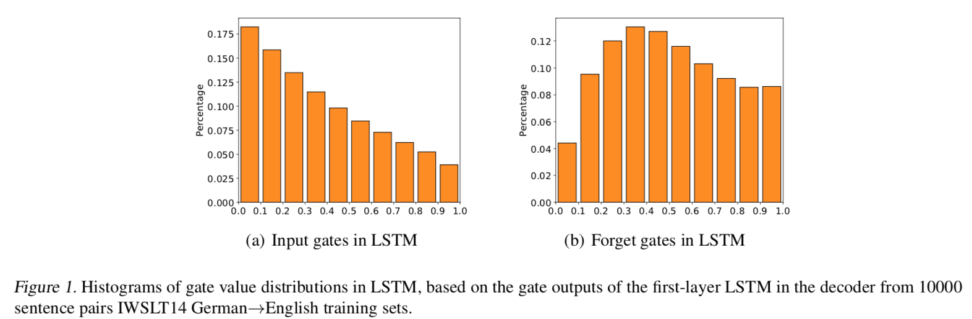
Introduction
By using such gates with many more parameters, LSTM usually performs much better than conventional RNNs. However, when looking deep into the unit, we empirically find that the values of the gates are not that meaningful as the design logic.
At the same time,several works (Murdoch & Szlam, 2017; Karpathy et al.,2015) show that most cell coordinates of LSTM are hard to find particular meanings.
Notes:
LSTM通常比傳統RNN執行得更好。然而，深入研究單元時，會發現gate的價值沒有那麼有意義。
在圖1中，分佈在forget gates和input gates不清晰大多數值處於中間狀態（大約0.5），這意味著大多數門閥值在LSTM中是不明確的。
其他作者也表明LSTM的大多數細胞坐標很難找到特別的意義。

Slide 6
Introduction
In this paper, we propose to push the values of the gates to the boundary of their ranges (0, 1).1 Pushing the values of the gates to 0/1 has certain advantages.
First, it well aligns with the original purpose of the development of gates: to get the information in or skip by “opening” or “closing” the gates during the recurrent computation, which reflects more accurate and clear linguistic and structural information.
Second, similar to BitNet in image classification (Courbariaux et al., 2016), by pushing the activation function to be binarized, we can learn a model that is ready for further compression.
Third, training LSTM towards binary-valued gatesenables better generation of the learned model.
Notes:
所以本篇將門閥的值推向它們的範圍邊界（0,1），將邊界推向0與1有下列優勢
首先，它很好地符合門的發展的最初目的：到通過“打開”或“關閉”獲取訊息或跳過反復計算期間的門，反映更多準確而清晰的語言和結構信息。
第二，類似於圖像分類中的BitNet（Courbariaux 等人，2016），通過推動激活函數進行二值化，我們可以學習一個可以進一步壓縮的模型(更有效率)。
第三，將LSTM訓練為二進制值門 能夠更好地生成學習模型。

Slide 7
Introduction
Technically, pushing the outputs of the gates towards such discrete values is challenging. A straightforward approach is to sharpen the sigmoid function by a small temperature. However, this is equivalent to rescaling the input and cannot guarantee the values of the learned gates to be close to 0 or 1.
To tackle this challenge, in this paper, we leverage the Gumbel-Softmax estimator developed for variational methods (Jang et al., 2016; Maddison et al., 2016).
We apply the Gumbel-Softmax estimator to the gates to approximate the values sampled from the Bernoulli distribution given by the parameters, and train the LSTM model with standard backpropagation methods. We call the learned model Gumbel-Gate LSTM (G2 -LSTM).
Notes:
將門閥值的輸出推向了這樣的位置離散值是具有挑戰性。透過鋭化sigmoid fumction。但是，這相當於重新調整輸入而不能保證學習門的值接近0或者1。
所以，在本文中利用 Gumbel-Softmax來開發的方法
透過Gumbel-Softmax運用於門閥估計從參數給出的伯努利分佈中採樣的值，並使用標準的反向傳播方法訓練LSTM模型。我們稱之為學習模型Gumbel-Gate LSTM（G2 -LSTM）。

Slide 8
Introduction
Our method restricts the gate outputs to be close to the boundary, and thus reduces the representation power. Surprisingly, there is no performance drop. Furthermore, our model achieves better or comparable results compared to the baseline model.
Our learned model is easy for further compression. We apply several model compression algorithms to the parameters in the gates, including low-precision approximation and low-rank approximation, and results show that our compressed model can be even better than the baseline model without compression.
We investigate a set of samples and find that the gates in our learned model are meaningful and intuitively interpretable. We show our model can automatically learn the boundaries in the sentences.
Notes:
方法限制門輸出接近邊界，從而降低了表現力。 但是，沒有性能下降。此外，模型可以獲得更好與其他模型的可比性。
學習模型很容易進一步壓縮。將幾種模型壓縮算法應用於門閥中的參數，包括低精度預估和低排序預估，結果表明本文壓縮模型可以好比沒有壓縮模型更好
本文調查了一組樣本並找到gate在學習的模型中，有意義且直觀解釋。可以自動顯示模型學習句子的界限。

Slide 9
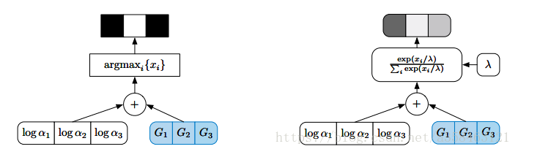
Background
Gumbel-Softmax Estimator
Jang et al. (2016) and Maddison et al. (2016) develop a continuous relaxation of discrete random variables in stochastic computational graphs. The main idea of the method is that the multinomial distribution can be represented according to Gumbel-Max trick, thus can be approximated by Gumbel Softmax distribution. In detail, given a probability distribution over k categories with parameter π1, π2, . . . , πk, the Gumbel-Softmax estimator gives an approximate one-hot sample y with
By using the Gumbel-Softmax estimator, we can generate sample y = (y1, ..., yk) to approximate the categorical distribution. Furthermore, as the randomness q is independent of π (which is usually defined by a set of parameters), we can use reparameterization trick to optimize the model parameters using standard backpropagation algorithms. Gumbel-Softmax estimator has been adopted in several applications such as variation autoencoder (Jang et al., 2016), generative adversarial network (Kusner & Hernández-Lobato, 2016), and language generation (Subramanian et al., 2017). To the best of our knowledge, this is the first work to introduce the Gumbel-Softmax estimator in LSTM for robust training purpose.
Notes:
連續離散隨機變數在隨機計算圖中，並使用Gumbel-Max技巧，讓結果可以較接近原本分布。
透過使用Gumbel-Softmax Estimator，我們可以生成樣本y =（y1，...，yk）來近似分類分佈。此外，由於隨機性q獨立於π（通常由一組參數定義），我們可以使用重新參數化技巧來優化使用標準反向傳播算法的模型參數。
Gumbel-Softmax估計器已被多種應用所採用，例如變量自動編碼器（Jang 等人，2016），生成對抗網絡（Kusner＆ Hernández-Lobato，2016）和語言生成（Subramanian等，2017）。據我們所知，這是第一部介紹Gumbel-Softmax Estimator運用在LSTM訓練上。
https://www.itread01.com/content/1545003007.html

Slide 10
Background
Loss surface and generalization
The concept of sharp and flat minima has been first discussed in (Hochreiter & Schmidhuber, 1997a; Haussler et al., 1997). Intuitively, a flat minimum x of a loss f(·) corresponds to the point for which the value of function f varies slowly in a relatively large neighborhood of x. In contrast, a sharp minimum x is such that the function f changes rapidly in a small neighborhood of x. The sensitivity of the loss function at sharp minima negatively impacts the generalization ability of a trained model on new data.
Recently, several papers discuss how to modify the training process and to learn a model in a flat region so as to obtain better generalization ability. Keskar et al. (2016) show by using small-batch training, the learned model is more likely to converge to a flat region rather than a sharp one. Chaudhari et al. (2016) propose a new objective function considering the local entropy and push the model to be optimized towards a wide valley.
Notes:
損失f（·）的平坦最小值x對應於函數f的值在x的相對大的鄰域中緩慢變化的點。相反，sharp的最小x使得函數f在x的小鄰域中快速變化。sharp最小值處的損失函數的敏感性負面影響訓練模型對新數據的泛化能力。
通過使用小批量訓練顯示，學習模型更可能收斂到平坦區域。

Slide 11
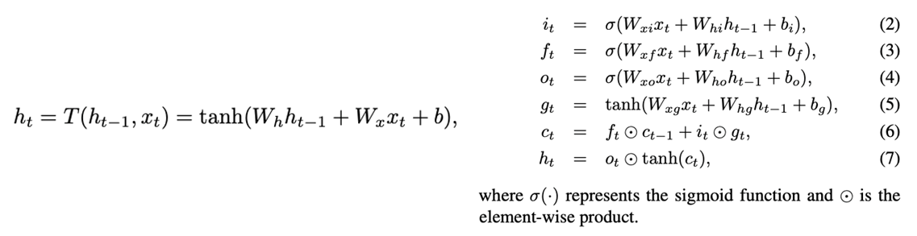
The Proposed Training Algorithm
Long Short-Term Memory RNN
LSTM
RNN
Notes:
此部分為RNN與LSTM公式
LSTM單元需要比參數更多的參數，大參數的百分比用於計算門 （sigmoid）功能。

Slide 12
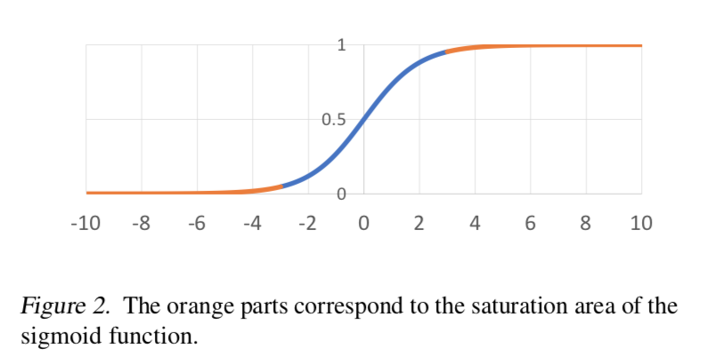
The Proposed Training Algorithm
Training LSTM Gates Towards Binary Values
If we can push the outputs of the gates to the saturation area of the sigmoid function (i.e., towards 0 or 1), the loss function with respect to the parameters in the gates will be flat: if the parameters in the gates perturb, the change to the output of the gates is small due to the sigmoid operator (see Figure 2)
The change to the loss is little, which means the flat region of the loss. First, as such model is robust to small parameter changes, it is robust to different model compression methods, e.g., lowprecision compression or low-rank compression.
Second, as discussed in (Chaudhari et al., 2016), minima in a flat region is more likely to generalize better, and thus toward binary-valued gates may lead to better test performance.
Notes:
如果我們可以推動gate的輸出到sigmoid函數的飽和區域（即朝向 0或1），關於門中參數的損耗函數將是平坦的：如果門中的參數擾動，由於sigmoid形運算符，門的輸出變化很小（見圖2）
然後損失會變小，這代表損失的平坦區域。第一， 因為這樣的模型對於小的參數變化是穩健的，它是對不同的模型壓縮方法是穩健的，例如，低精度壓縮或低排序壓縮。
第二， 正如相關作者所討論的那樣，最小平坦區域更有可能更好的結果，從而朝向二進制值門可以帶來更好的測試性能。

Slide 13
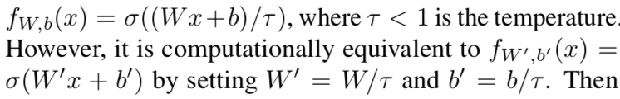
The Proposed Training Algorithm
Training LSTM Gates Towards Binary Values
However, the task of training towards binary-valued gates is quite challenging. One straightforward idea is to sharpen the sigmoid function by using a smaller temperature.
Then using a small temperature is equivalent to rescale the initial parameters as well as the gradients to a larger range. Usually, using an initial point in a large range with a large learning rate will harm the optimization process, and apparently cannot guarantee the outputs to be close to the boundary after training.
Notes:
透過較小的tempture參數來銳化Sigmoid功能，通常，在大範圍內使用具有大學習率的初始點將損害優化過程，並且顯然不能保證輸出在訓練之後接近邊界。

Slide 14
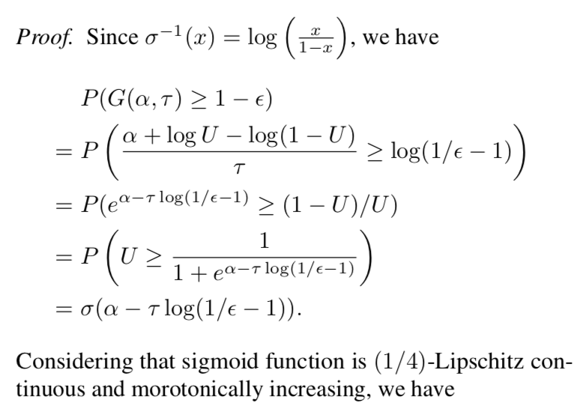
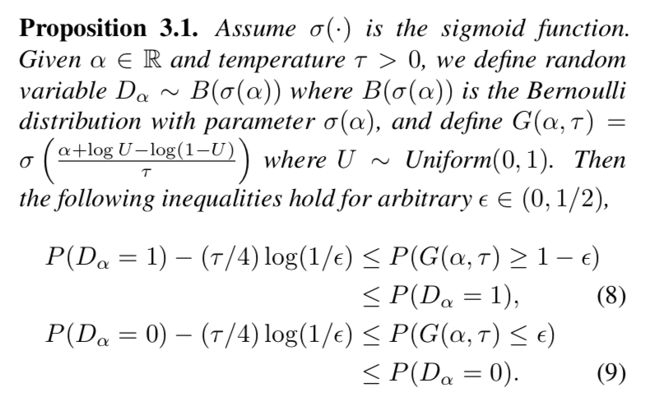
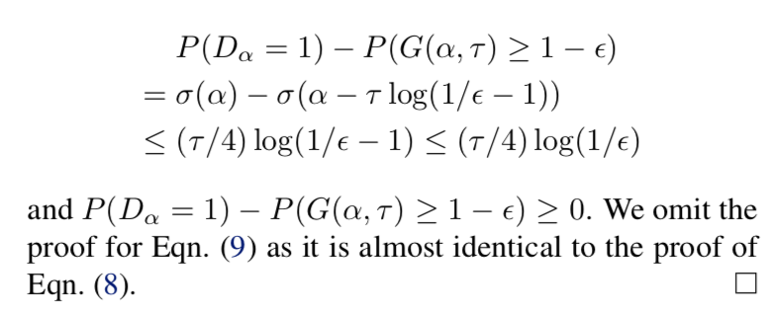
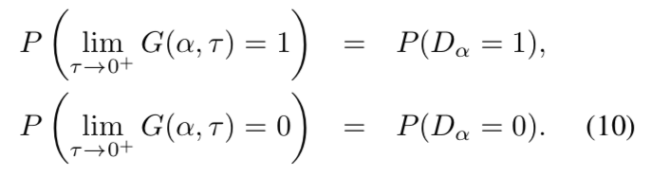
The Proposed Training Algorithm
Training LSTM Gates Towards Binary Values
In this work, we leverage the recently developed Gumbel Softmax trick. This trick is efficient in approximating discrete distributions, and is one of the widely used methods to learn discrete random variables in stochastic computational graphs. We first provide a proposition about the approximation ability of this trick for Bernoulli distribution, which will be used in our proposed algorithm.
Notes:
我們利用最近開發的GumbelSoftmax技巧。這種技巧在近似離散分佈中是有效的，並且是在隨機計算圖中學習離散隨機變量的廣泛使用的方法之一。我們首先提出關於伯努利分佈的這種技巧的近似能力的命題，這將在我們提出的算法中使用。

Slide 15
The Proposed Training Algorithm
Training LSTM Gates Towards Binary Values
In particular, we only push the outputs of input gates and forget gates towards binary values as the output gates usually need fine-granularity information for decision making which makes binary values less desirable. To justify this, we conducted similar experiments and observed a performance drop when pushing the output gates to 0/1 together with the input gates and the forget gates.
In the forward pass, we first independently sample values for U in each time step, then update G2 -LSTMs using Eqn. (11) - (16) and calculate the loss, e.g., negative log likelihood loss. In the backward pass, as G is continuous and differentiable with respect to the parameters and the loss is continuous and differentiable with respect to G, we can use any standard gradient-based method to update the model parameters.
Notes:
透過這種方式，可以優化二進制值門。只將input gate的output的值與forget gate的值推向二元值，output gate通常需要精細訊息用於決策這使二進制值理不理想。為了證明這一點，進行了類似的實驗並觀察了性能，將input gates 與 forget gates的輸出推向0與1，。
在前向傳遞中，我們首先獨立採樣值U在每個時間，然後更新G2 -LSTMs使用Eqn。
在向後傳球中，因為G是連續且可微分的關於參數和損失是連續的相對於G而言，我們可以使用任何標準基於梯度的方法來更新模型參數。

Slide 16
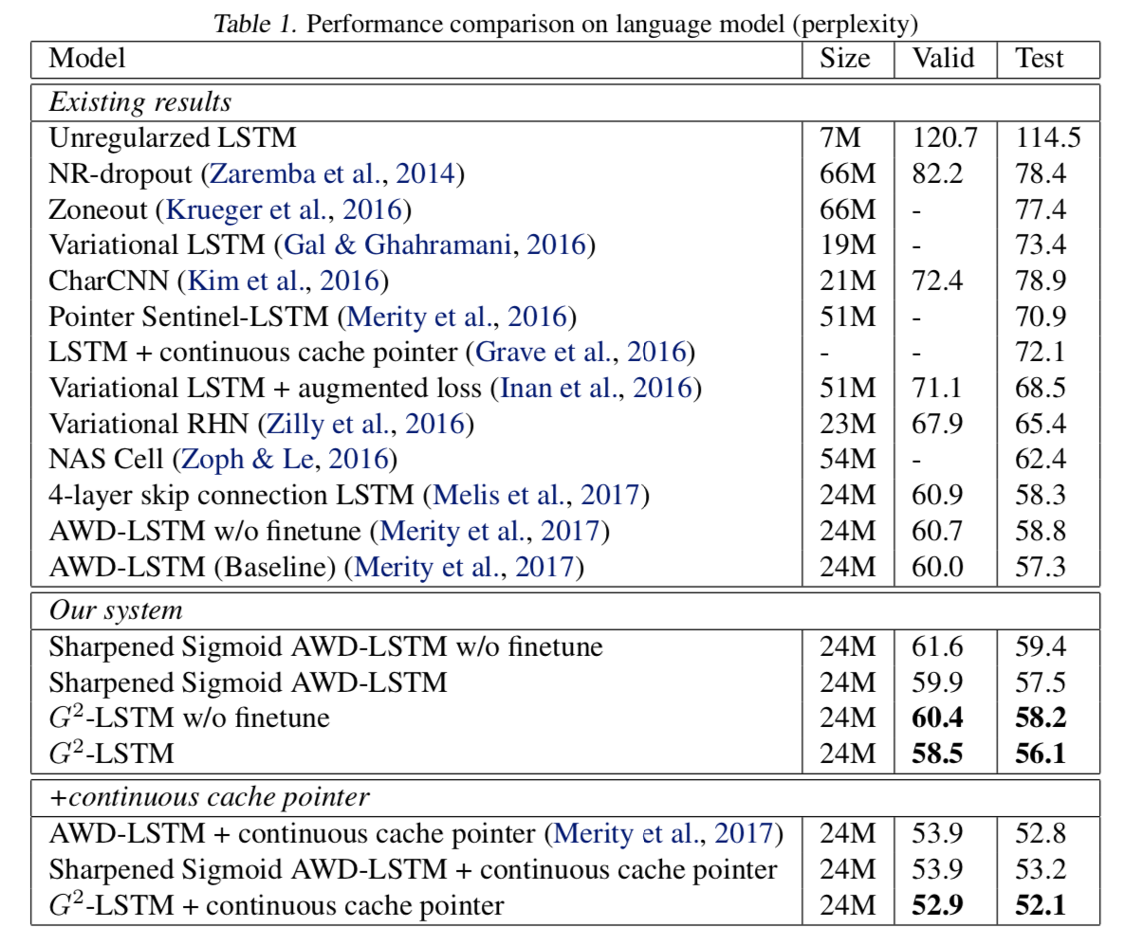
The Proposed Training Algorithm
Training LSTM Gates Towards Binary Values

Slide 17
Experiment
LANGUAGE MODELING
LANGUAGE MODELING
The task is to train an LSTM model to correctly predict the next word conditioned on previous words. A model is evaluated by the prediction perplexity: smaller the perplexity, better the prediction.
We followed the practice in (Merity et al., 2017) to set up the model architecture for LSTM: a stacked three-layer LSTM with drop-connect (Wan et al., 2013) on recurrent weights and a variant of averaged stochastic gradient descent (ASGD) (Polyak & Juditsky, 1992) for optimization, with a 500-epoch training phase and a 500-epoch finetune phase. Our training code for G2-LSTM was also based on the code released by Merity et al. (2017). Since the temperature τ in G2-LSTM does not have significant effects on the results, we set it to 0.9 and followed all other configurations in Merity et al. (2017). We added neural cache model (Grave et al., 2016) on the top of our trained language model to further improve the perplexity.
Notes:
此任務是訓練LSTM模型以正確預測以前單詞為條件的下一個單詞。通過預測困惑來評估模型：較小的困惑，更好的預測。
此部分說明語言模型參考相關作者設計的部分。使用三層的LSTM模型與ASGD優化，500 Epoch training 與 500 Epoch finetune，將tempture設定在0.9，加入neural cache model在模型改善困惑度

Slide 18
Experiment
MACHINE TRANSLATION
(1) IWSLT’14 German→English translation dataset (Cettolo et al., 2014), which is widely adopted in machine learning community (Bahdanau et al., 2016; Wiseman & Rush, 2016a; Ranzato et al., 2015). The training/validation/test sets contain about 153K/7K/7K sentence pairs respectively, with words pre-processed into sub-word units using byte pair encoding (BPE) (Sennrich et al., 2016). We chose 25K most frequent sub-word units as the vocabulary for both German and English.
(2) English→German translation dataset in WMT’14, which is also commonly used as a benchmark task to evaluate different NMT models (Bahdanau et al., 2014; Wu et al., 2016; Gehring et al., 2017; He et al., 2017). The training set contains 4.5M English→German sentence pairs, Newstest2014 is used as the test set, and the concatenation of Newstest2012 and Newstest2013 is used as the validation set. Similarly, BPE was used to form a vocabulary of most frequent 30K subword units for both languages.
In both datasets, we removed the sentences with more than 64 sub-word units in training. For the German→English dataset, we adopted a stacked two-layer encoder-decoder framework. We set the size of word embedding and hidden state to 256.
Notes:
此部分說明翻譯資料集
德文至中文部分使用IWSLT’14資料，預處理使用byte pair encoding方法。
英文至德文WMT’14資料，也使用byte pair encoding方法處理資料。
兩者 資料均去除64子詞單元，在德文至英文部分使用兩階層 encoder-decoder 架構，將word embedding 與 hidden state 設定至 256

Slide 19
Experiment
Experimental Results
The experimental results are shown in Table 1 and 2. We compare our training method with two algorithms. For the first algorithm (we call it Baseline), we remove the Gumble-Softmax trick and train the model using standard optimization methods. For the second algorithm (we call it Sharpened Sigmoid), we use a sharpened sigmoid function as described in Section 3.2 by setting τ = 0.2 and check whether such trick can bring better performance.
Notes:
第一個算法（我們稱之為Baseline），我們刪除了 Gumble-Softmax技巧並使用標準訓練模型優化方法。
第二種算法（我們稱之為 Sharpened Sigmoid），我們使用尖銳的Sharpened Sigmoid如3.2節所述，設定τ= 0.2並檢查 這種技巧是否能帶來更好的表現。

Slide 20
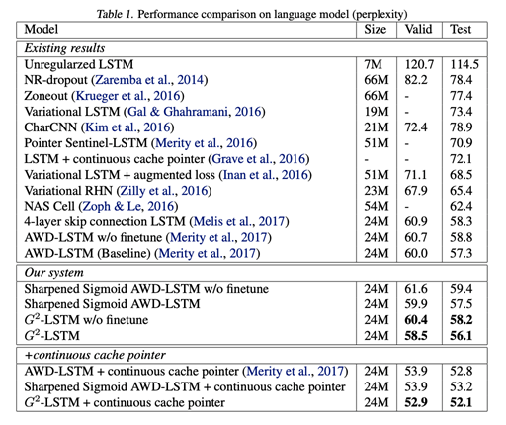
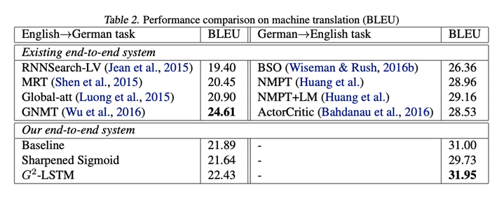
Experiment
Notes:
Plexity值越低較佳
BLEU較高較佳
在language model我們的模型優於其他作者
在machine translation部份，唯一不同在G2-LSTM為訓練演算法，雖然它們採用相同的模型結構，G2的效果更好 -LSTM證明了我們提出的訓練方法的有效性。這表明了這一點 將門的輸出限制為二進制值 根本不會帶來性能下降。相反， 表現甚至更好。我們得出結論，這樣的好處可能來自更好的泛化能力。
我們還列出了以往文學作品的表現， 可以採用不同的模型架構或設置。 對於語言建模，與表中列出的先前工作相比，我們獲得了更好的性能結果。對於英語→德語翻譯，我們的結果是 比GNMT更差（Wu et al。，2016）因為他們使用堆疊 八層模型，而我們只使用三層模型。

Slide 21
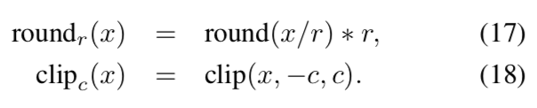
Experiment
Sensitivity Analysis - Low-Precision Compression
We compressed parameters in the input and forget gates to lower precision. Doing so the model can be compressed to a relatively small size. In particular, we applied round and clip operations to the parameters of the input and forget gates:
Notes:
接下來是敏感性分析，壓縮 input and forget gates參數，所以模型可以變較小，並使用round and clip在input and forget gates
測試了兩種低精度壓縮設置。在第一個設置（命名為Round）中，我們使用Eqn舍入參數。 （17）。通過這種方式，我們減少了門中參數的支持集。在第二個設置（命名為Round＆Clip）中，我們使用Eqn進一步將舍入值剪切為固定範圍。 （18）因此限制了不同值的數量。由於這兩個任務差別很大，我們為語言建模任務設置了舍入參數r = 0.2和剪輯參數c = 0.4，並為神經機器翻譯設置了c = 1.0和r = 0.5。因此，語言建模中的輸入門和遺忘門的參數只能取（0.0，±0.2，±0.4）和（0.0，±0.5，±1.0）的值用於機器翻譯。

Slide 22
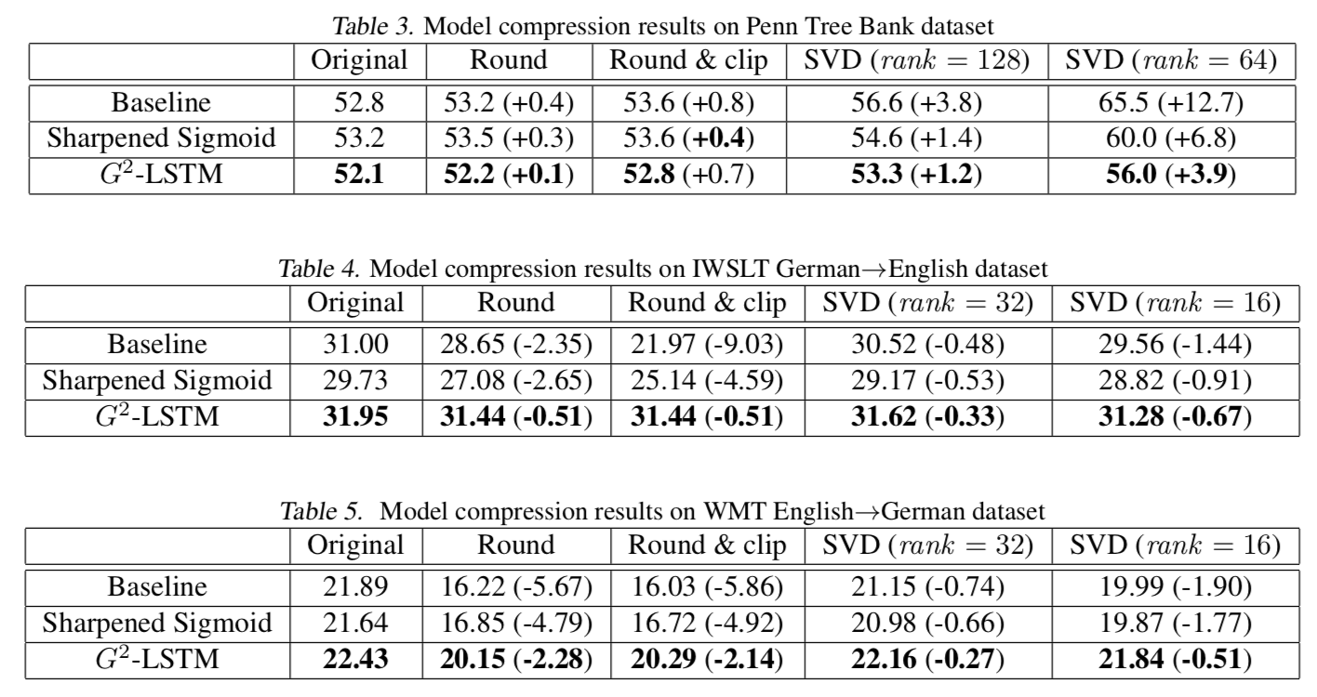
Experiment
Sensitivity Analysis - Low-Rank Compression
We compressed parameter matrices of the input/forget gates to lower-rank matrices through singular value decomposition, which can reduce the model size and lead to faster matrix multiplication. Given that the hidden states of the task of language modeling were of much larger dimension than that of neural machine translation, we set rank = 64/128 for language modeling and rank = 16/32 for neural machine translation.
Notes:
我們將輸入/忘記門的參數矩陣壓縮到較低排序的矩陣通過奇異值分解，可以減少模型大小導致更快的矩陣乘法。特定語言建模任務的隱藏狀態是 比神經機器翻譯更大的維度，我們設置rank = 64/128用於語言建模和 rank = 16/32用於神經機器翻譯。
在語言模型上低精度壓縮都非常穩健
在機器翻譯上可以獲得與具有完整參數的模型大致相當的翻譯精度。所有結果表明，使用我們提出的方法訓練的模型對參數壓縮不太敏感。

Slide 23
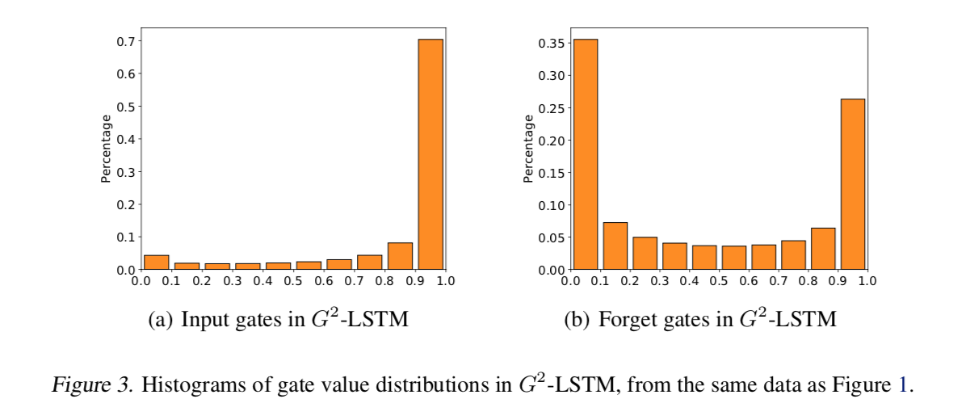
Experiment
Visualization of the Gates
We show the value distribution of the gates trained using classic LSTM and G2-LSTM. To achieve this, we sampled 10000 sentence pairs from the training set and fed them into the learned models. We got the output value vectors of the input/forget gates in the first layer of the decoder. We recorded the value of each element in the output vectors and plotted the distributions in Figure 1 and 3.
Notes:
我們從訓練集中抽取了10000個句子對，並將它們輸入到學習模型中。我們得到了解碼器第一層中輸入/忘記門的輸出值向量。我們記錄了輸出向量中每個元素的值，並繪製了圖1和圖3中的分佈。
在LSTM中，門閥極值的分佈是相對均勻的並且具有沒有明確的集中。相反，輸入的值 G2的大門 -LSTM集中在靠近的地區 1，這表明我們學到的模型試圖保持最多來自輸入詞的訊息;忘記門閥集中在邊界區域，接近0的區域或接近1的區域。這一觀察表明我們的訓練算法符合我們的期望 並成功將大門推至0/1。

Slide 24
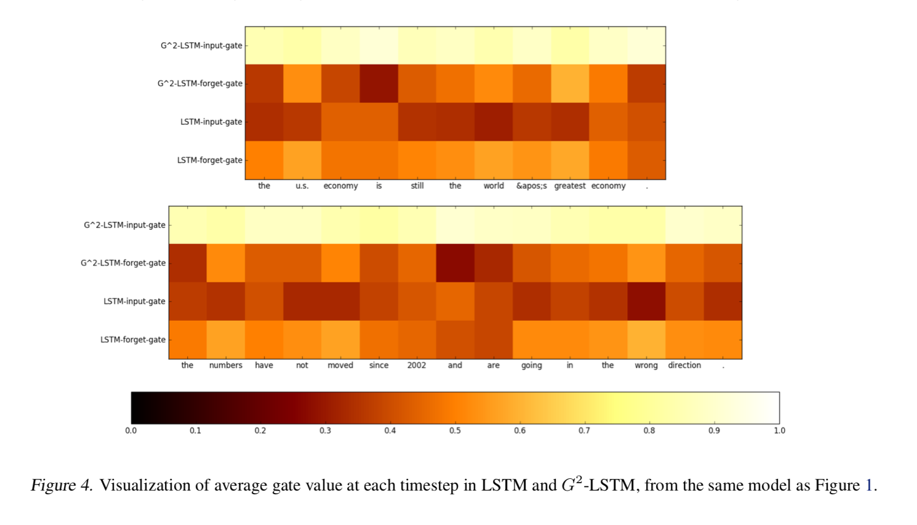
Experiment
Visualization of the Gates
Besides the overall distribution of gate values over a sampled set of training data, here we provide a case study for sampled sentences. We calculated the average value of the output vector of the input and forget gate functions for each word. In particular, we focused on the average value of the input/forget gate functions in the first layer and check whether the averages are reasonable. We plot the heatmap of the English sentence part in Figure 4.
Notes:
除了在一組採樣訓練數據上的門值的總體分佈之外，這裡我們提供了一個抽樣句子的案例研究。
計算了每個字的輸入和遺忘門函數的輸出向量的平均值。特別是，我們關注第一層中輸入/遺忘門函數的平均值，並檢查平均值是否合理。
G2-LSTM不會降低輸入門功能的信息，因為所有字的平均值都相對較大。相反，LSTM的輸入門的平均值有時很小（小於0.5），即使對於像“錯誤”這樣的有意義的詞也是如此。
由於這些單詞未包含在LSTM中，因此無法對其進行有效編碼和解碼，從而導致錯誤的轉換結果。
其次，對於G2-LSTM，忘記門的值小的大多數單詞是功能詞（例如，連詞和標點符號）或子句中的邊界。也就是說，我們的訓練算法確實確保了模型忘記有關句子邊界的信息，並用新輸入重置隱藏狀態。

Slide 25
Conclusion and Future Work
In this paper, we designed a new training algorithm for LSTM by leveraging the recently developed Gumbel Softmax Estimator. Our training algorithm can push the values of the input and forget gates to 0 or 1, leading to robust LSTM models. Experiments on language modeling and machine translation demonstrated the effectiveness of the proposed training algorithm.
We will explore following directions in the future. First, we will apply our algorithm to deeper models (e.g., 8+ layers) and test on larger datasets. Second, we have considered the tasks of language modeling and machine translation. We will study more applications such as question answering and text summarization.
Notes:
在本文中，利用開發的Gumbel Softmax estimator為LSTM設計了一種新的訓練算法。訓練算法可以將輸入和忘記門的值推到0或1，從而產生強大的LSTM模型。語言建模和機器翻譯的實驗證明了所提出的訓練算法的有效性。
將在未來探索以下方向。首先，我們 將我們的算法應用於更深層次的模型（例如，8 +層） 並測試較大的數據集。其次，我們考慮過了 語言建模和機器翻譯的任務。我們 將研究更多的應用，如問答和文字摘要。

